Slide 1
Microservices and DevOps
DevOps and Container Technology
Docker
Henrik Bærbak Christensen

Slide 2
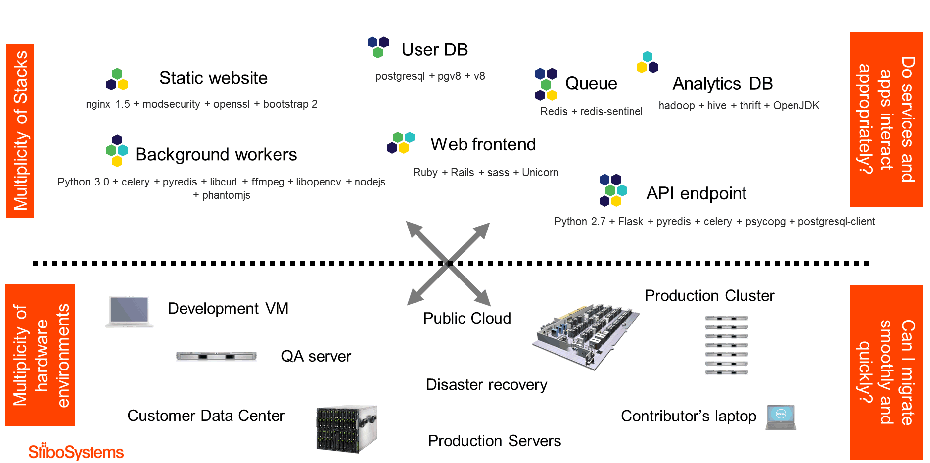
The DevOps Problem
Crossing boundaries, that is, moving code
Source: Torben Haagh, StiboSystems

Slide 3
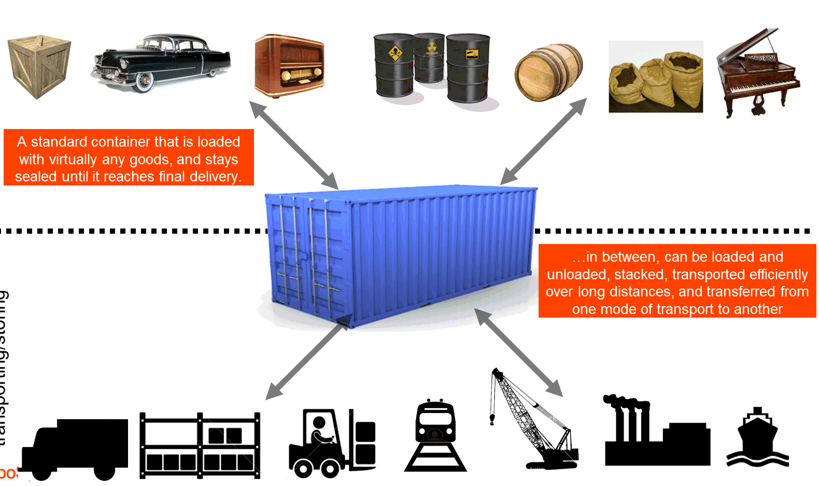
Was Solved in 1960’ies

Slide 4
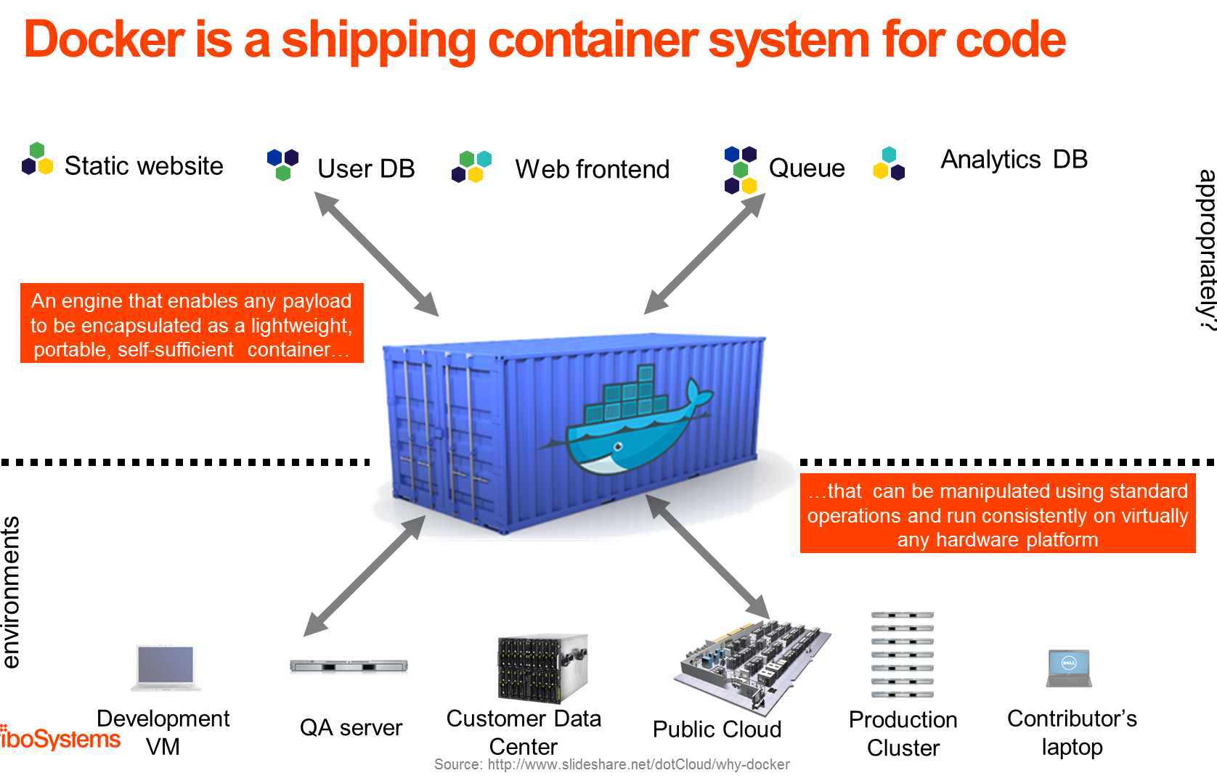
Docker = Container

Slide 5
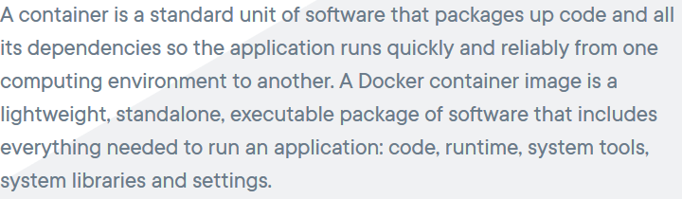
Definition
(Docker web site, 2019)
That is, not just program/code, but the required execution environment

Slide 6
Containers are Virtual Machines

Slide 7
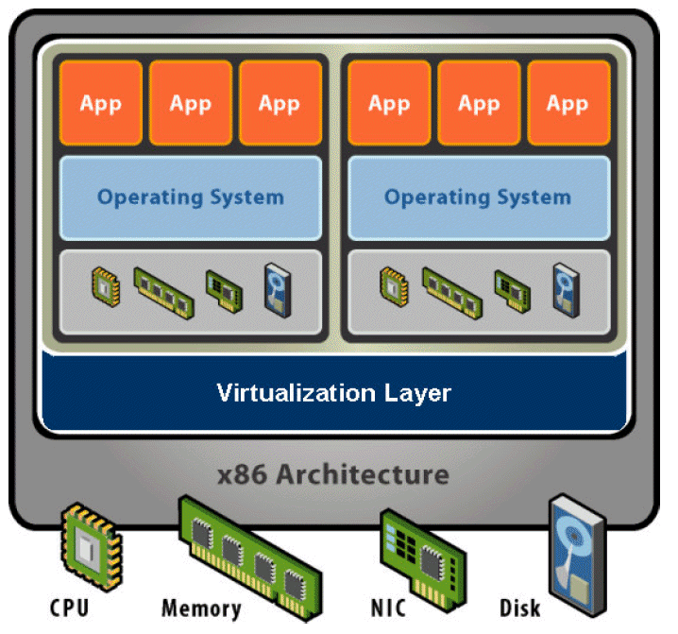
A Virtual Machine
Hardware Abstraction
Virtual processor, memory, devices, etc.
Virtualization Software
Indirection: Decouple hardware and OS
Multiplex physical hardware across guest VMs

Slide 8
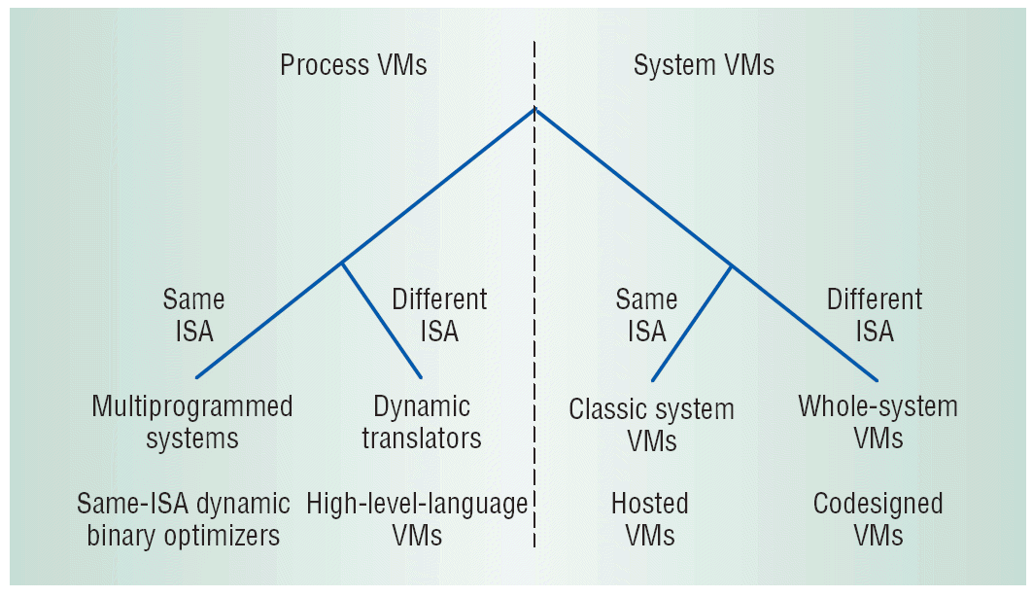
Types of VMs
Smith & Nair 2005
Two super classes
Process VM
System VM
Both can be sub classed based upon supporting virtualization of same or different ISA (Instruction Set Architecture).

Slide 9
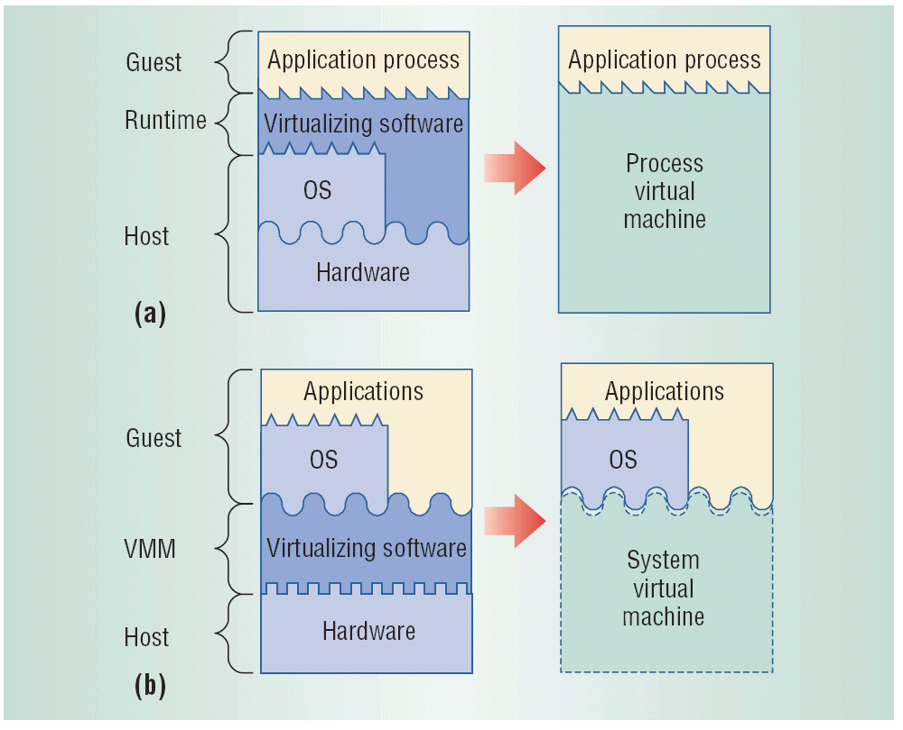
Process / System VM
Ex: Java VM
Ex: VMWare

Slide 10
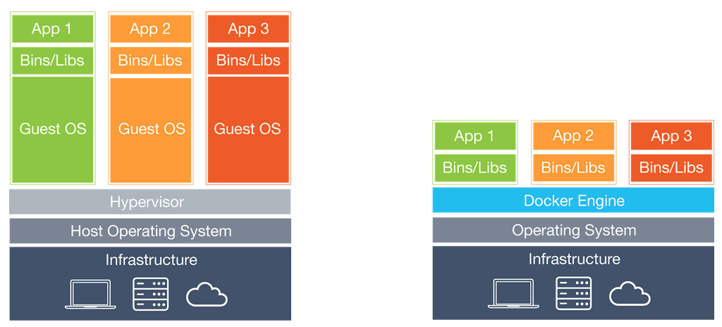
Moving the boundary
Mission: To make virtualization lightweight
Traditional VMs
Docker

Slide 11
Classifying Docker
A Same-ISA Process VM
Docker containers provide a virtual Linux OS
Docker containers typically execute a single process
Ex: Run a RabbitMQ broker, an apache web server, …

Slide 12
Docker Engine
The VMM of Docker

Slide 13
Images and Containers
Core concepts in Docker
Image The encapsulation of a VM
I.e. the physical file that contains the VM – deployment unit
Similar to a Java Jar file, DLL, .exe, war file, etc.
Container The executing instance of an image
Similar to an executing Java system, running the main() from the Jar file
Docker Engine The VMM program on Linux (Windows)
That handles images and executes containers

Slide 14
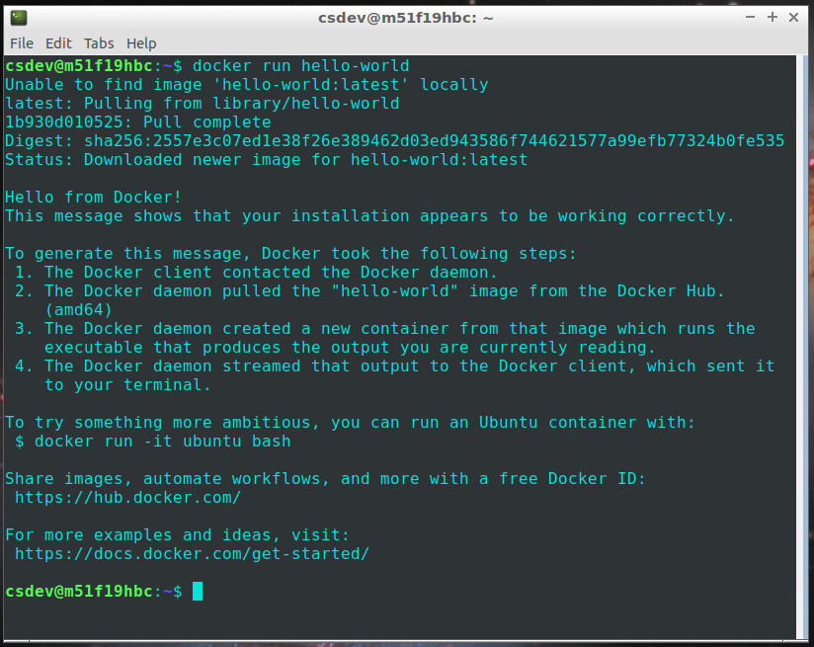
Example

Slide 15
Example
‘docker’ = invoke docker engine
‘run’ = instantiate container from named image
‘hello-world’ = named image (parameter to ‘run’)

Slide 16
Host and Guest
Now, you have two ”computers in one” – which is which?
Host: The physical machine, providing CPU, RAM, etc.
Guest: The virtual machine, handled by the VMM
Of course, hosts often run multiple guests…
And your laptop (host) runs M101 (guest) that is actually the host of the Docker guest !

Slide 17
Linux LXC technologies
Container
Application running on a slice/view of a (shared) OS
Linux LXC technology extended
namespaces (isolation) provides an isolated share of OS resources
cgroups (configuration) provides resource management of OS resources (RAM, cpu, …)

Slide 18
Docker Image

Slide 19
Images
Onion file system: Copy-on-Write
Every operation basically creates a new file layer
Changing ‘hans.txt’ in layer N creates a (modified) copy of ‘hans.txt’ in layer N+1
Base images = ‘prebaked file system’
All layers up-till N forms an Image
I.e. henrikbaerbak/cloudarch:e16.1
Ubuntu 16.04 LTS server base image
Java, Ant, Ivy, Git, … are all layered on top
Layer N+1
Layer N
…
Base Layer

Slide 20
Building Images
How do you build a traditional server?
Unbox the machine, power up, install Linux, install application suite and libraries, execute server software
Lifecycle - classic
container = instantiate(image1)
Docker run …
modify container
Install software, change files, add stuff, …
commit container → image2
Docker commit
Power up
Install your app
‘Freeze’ the machine

Slide 21
Dockerfiles
Infrastructure-as-code

Slide 22
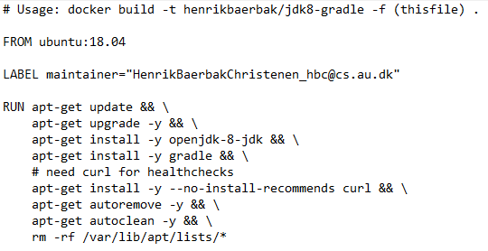
Building Images
Lifecycle – infrastructure-as-code
You automate the install script: Dockerfile
Example: henrikbaerbak/jdk8-gradle

Slide 23
Anatomy
State your base image
Identify yourself
Install software
WORKDIR set working directory in container
COPY copy <src> to <dest> (from host to cnt.)
RUN run command at build time
Configure
EXPOSE expose port to the outside
Execute
(ENTRYPOINT) state default script to run
CMD run command at run time (container process)

Slide 24
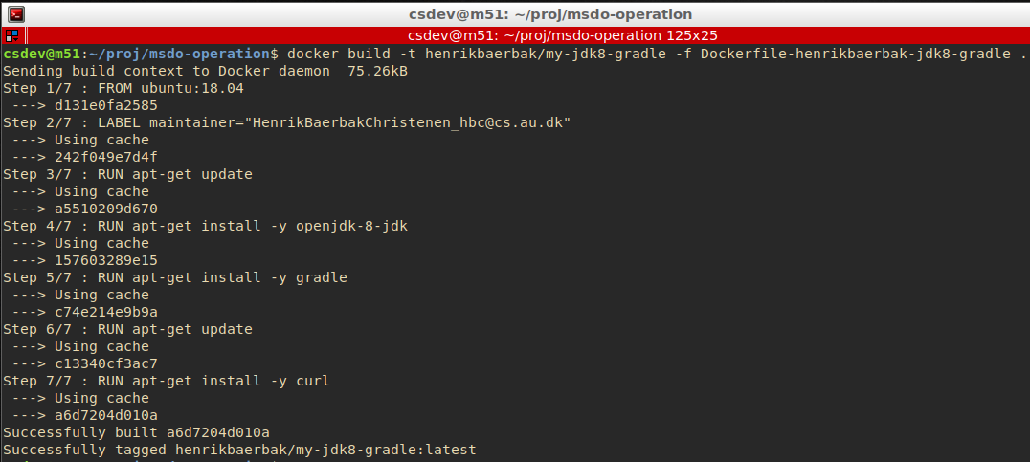
Building Image
-t = tag resulting image with given name
-f = dockerfile (default: Dockerfile)

Slide 25
Building Image
When ‘build’ is executed the host and the container co-exists and you typically copy files from host to image
Dockerfile is typically in the project root folder!
Version controlled along with project !!!
Modifiability QA: Group related things together – Cohesion
Host
Image
~/cave/build.gradle
/root/cave/build.gradle
COPY

Slide 26
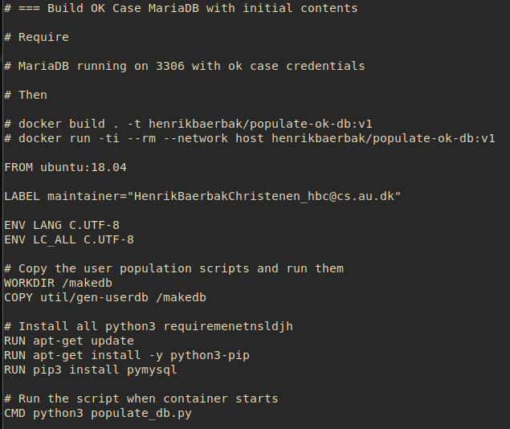
Example
Populate a DB
Populate_db.py
Runs against DB on localhost:3306
Exercise:
What happens?
To run

Slide 27
CMD vrs RUN
CMD = Execute
RUN = Execute
What is the difference???
Big!
RUN Execute at build time
That is, during the ‘docker build .’ phase
CMD Execute at container run time
That is, when the ‘docker run …’ is executed

Slide 28
No No’s
Much to my dislike, Docker has opted for using a .dockerignore file
Just like you have a .gitignore file
Wildcard specs of files not to add to git staging area
But! A Dockerfile is the infrastructure-code that explicitly states what goes into an image!
”Ups, by the way, I regret copying *.BAK files into the image, please remove them again”
Do not use .dockerignore !!! Except…
Notes:
Except: when gradle compiles .class files down into subproject folders

Slide 29
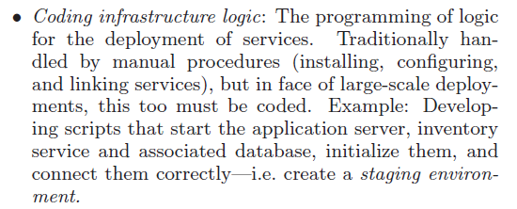
Infrastructure-as-code
DevOps is about speed and agility in going from Dev to Ops
Dockerfiles are one big piece of this puzzle: Installing the software on a server, is coded in a programming language, is under version control with your source !

Slide 30
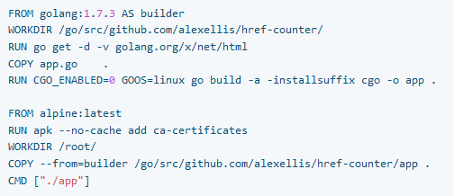
MultiStage DockerFiles
From Engine 17.05+
Idea
Build in steps
Step1: compile and assemble deployment unit (‘jar’ in Java)
Step2: produce container with just the jar and ‘execute’ CMD

Slide 31
Example Exercise
From the mandatory project
Step1:
Install the full SkyCave system
Finally RUN gradle to produce a ‘fatJar’ with full system in a single deployment unit
Step2:
Copy the fatJar from step1 and only that!
CMD to start skycave daemon using the fatJar

Slide 32
Docker Hub
Sharing Images

Slide 33
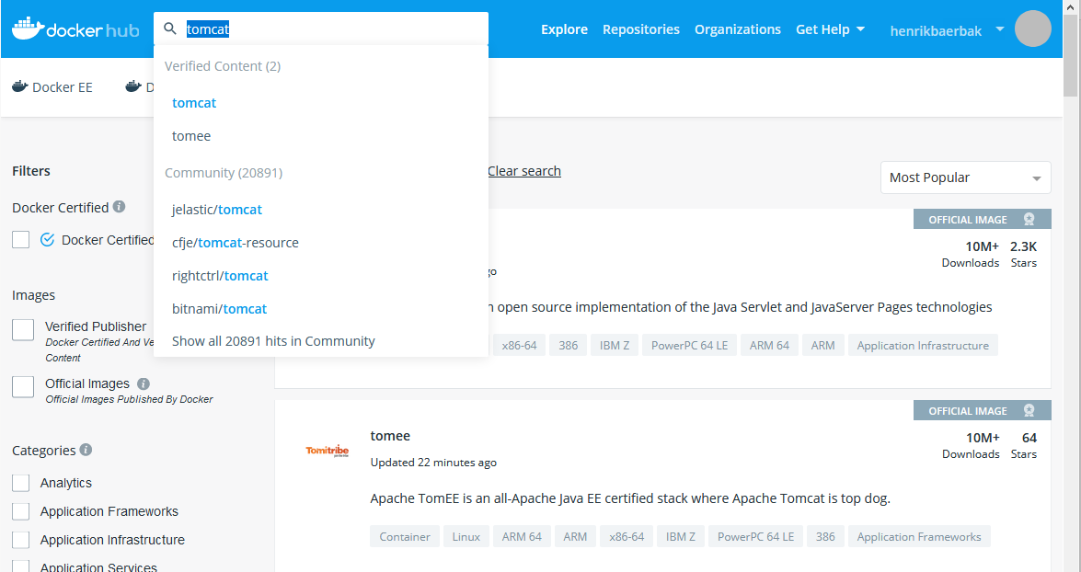
Docker Hub
‘Bootstrapping’ – where do I get the base layer from?
Docker Hub is a public repository of a lot of (base) images

Slide 34
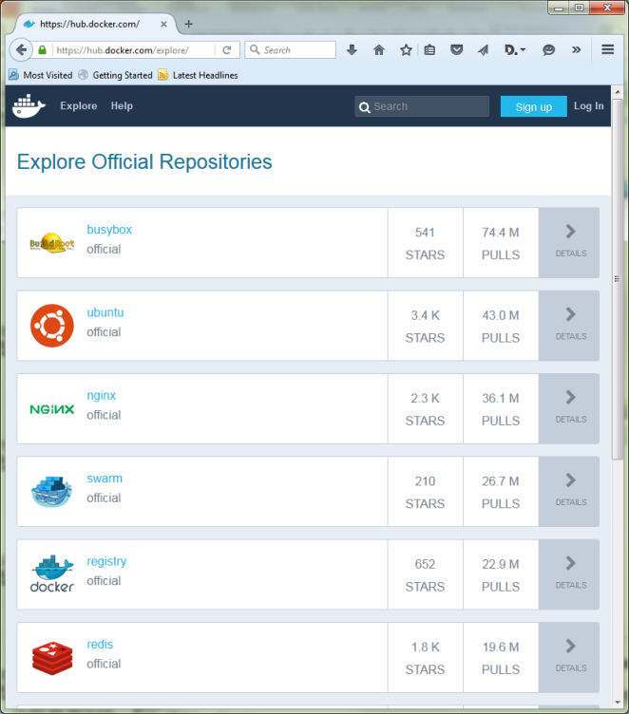
Docker Hub
The GitHub / Maven Repo movement
‘push’ your commits to a cloud base storage service
Mvnrepository / github / bitbucket …
‘pull/clone’ from there
Docker Hub
Register as a user (free)
Push your image to docker hub
Done!

Slide 35
Image Naming
Images can be called any name
Foobar, tmp, fiskesovs
However, if you have to push them to the hub, they have to follow the convention:
username/repository:tag
Only one docker hub repository can be private
I have called mine for ‘private’, and then use tags to differentiate different teaching images from each other...

Slide 36
Container Lifecycle Management
Docker 101

Slide 37
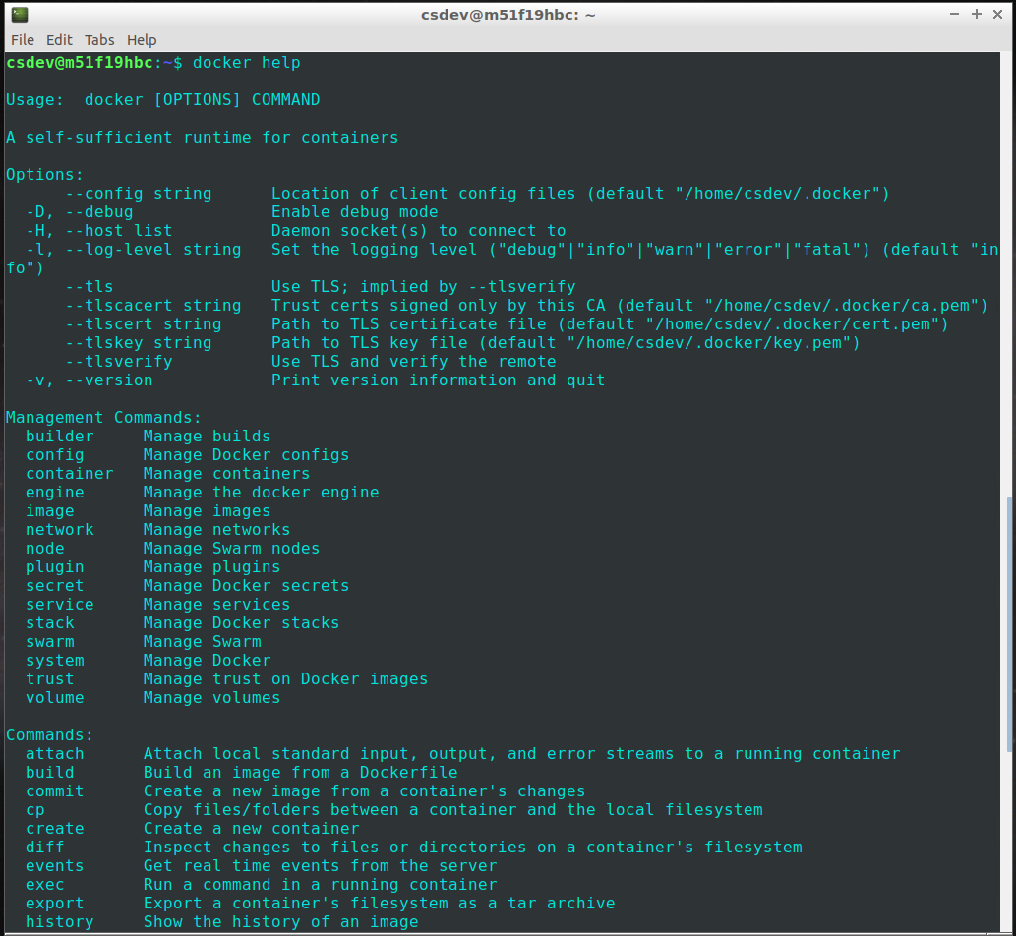
We need to…
Build images
Execute containers
Monitor containers
Kill containers

Slide 38
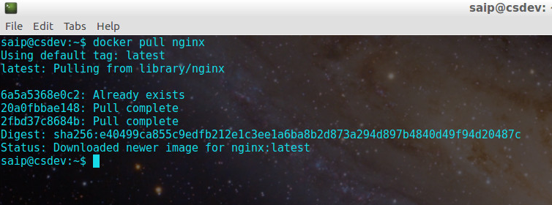
Images
‘pull’ = pull a named image from Hub
‘push’ = push a named image to Hub

Slide 39
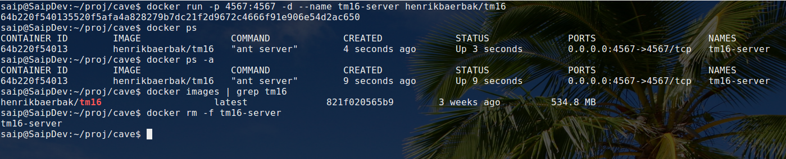
Containers
run = (pull image), and start container (-d = in background)
ps = see all running containers (-a = all, also the dead ones)
images = see all images
rm = remove container (-f =force, even if currently running)
OldSchool: docker ps = NewSchool: docker container ls

Slide 40
Docker run
Docker run (image) (command parameters)
Acceptable parameters defined by the image!
Zillion parameters, the most important are
docker run –d : -d = daemon mode / server
-ti: terminal interactive, so you can interact!
--name (myname): give it a name
-p (host):(container): port-mapping
--network=(network): define network to use
See later…

Slide 41
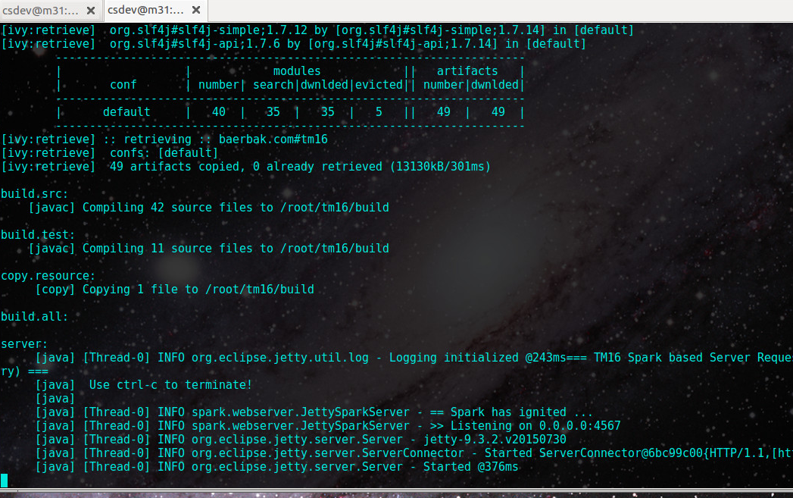
Containers
‘logs’ = See the log (shell output) of running container
‘logs –f’ = Tails the log (keeps running)

Slide 42
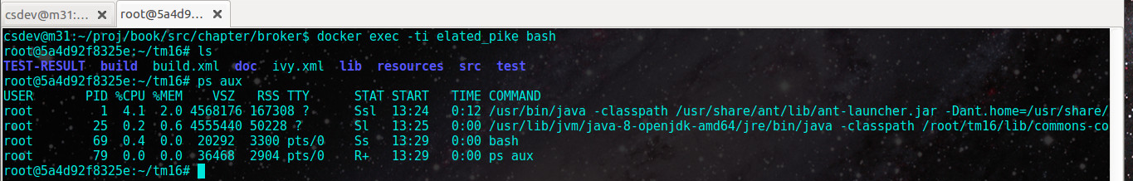
Containers
A container is very opaque ☹
What the heck is going on inside it ???
Where are the files located???
‘exec -ti (container) bash’
Is: execute ‘bash’ interactive TTY in a running container

Slide 43
Docker Networking
Microservices communicate, right?

Slide 44
Networking
Distributed systems rely on networking!
By default, network is an isolated resource in Docker!
Ten Apache web servers, all listening on port 80, on the same machine!
Two core technologies
Port forwarding
For ‘exposing’ container services to the outside/host
Docker network drivers
For ‘binding’ container services together securely

Slide 45
Port Forwarding
docker run -p 7777:6745 …
Bind container port 6745 in container to host’s external port 7777
So if you connect to ‘localhost:7777’ you will actually communicate with port 6745 of the service running in the docker container
Make docker services act like they are deployed on host

Slide 46
Network drivers
Any machine has several network interfaces
Linux: ‘lo’ = Local Loopback, ‘ens32’ = Ethernet, …
Docker will create new networks and attach containers to them
By default they are not shared among containers
docker run --network=container:daemon (image) cmd
This container will now reuse the network of container named ‘daemon’, i.e. they can communicate!
Other options are
--network=host reuse host’s network
--network=my-network use named network

Slide 47
Annoying Note
This note has cost me a fair share of gray hair!
What about firewalls?
On my DigitalOcean machines I want a firewall up!
Not my field of expertise, so ‘ufw’ = easy beginners linux firewall
But Docker –p circumvents ufw and ufw does not know!
Docker calls ‘iptables’ directly
So – Docker –p punch a hole in the firewall that you cannot deny using ufw ☹

Slide 48
Docker Volumes

Slide 49
Persistence
A container is self-contained
All ‘disks’ are virtual disks within the container
Practical for single-file deployments ☺ ☺ ☺
But... Not so practical for persistent data !!!
Docker Volumes
Is the solution to this issue – volumes are stored on host
Switch ‘- v hostfolder:containerfolder’ means ”mount hostfolder so it appears on path containerfolder’ in the container!

Slide 50
Exercise
What does the following do?
One caveat…
You have to know in which folder the service stores its persistent data
MongoDB: /data/db
MariaDB: /var/lib/mysql
Etc. ect.

Slide 51
Named Volumes
Actually ‘-v’ and mounted volumes is so yesterday…
Instead of mounting on the host, you can let Docker organize it using named volumes
Required when deploying on swarms!
So – we will return to that later…

Slide 52
Summary
Docker is a light-weight process VM technology based upon Linux
It will form the backbone throughout this course ☺
The learning curve is a bit steep – zillions of commands and parameters ☹

Slide 53
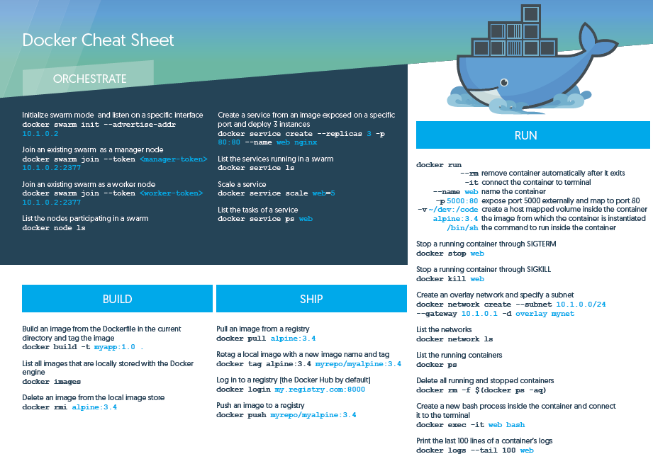
Find it on the Web ☺

